Slide 1

Data Science 101 - Lecture 4
Decentralized Data Science & MLOps
Practical Implementation with Ratio1
Professor: Andrei Ionut DAMIAN | Assistant: Vitalii Toderian
Politehnica University of Bucharest

Slide 2
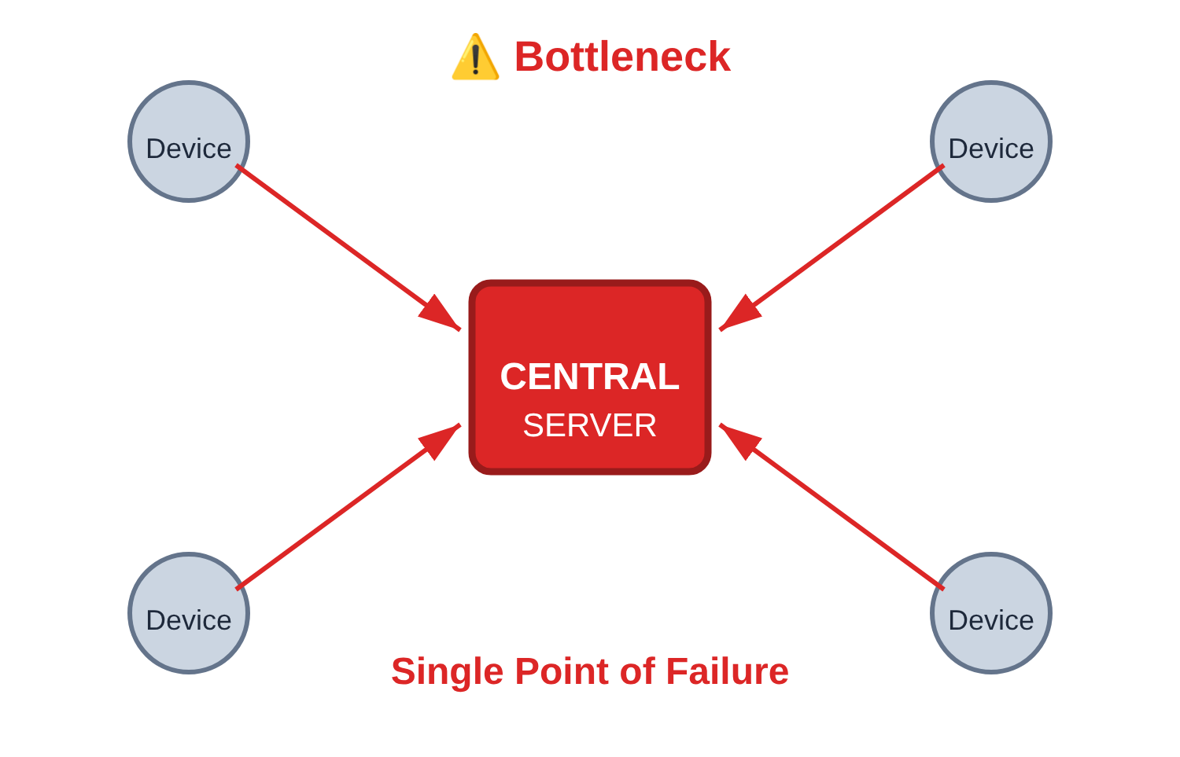
The Centralized Problem
💰 High Infrastructure Costs
🔗 Centralized Dependency
⚙️ Complex Workflows
🎓 Specialized Expertise Required
Insight: Billions of devices sit idle with unused compute capacity

Slide 3
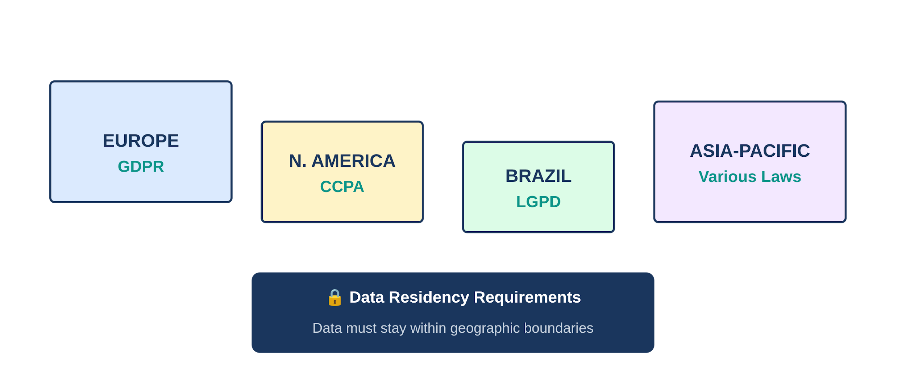
Privacy & Regulatory Landscape

Slide 4
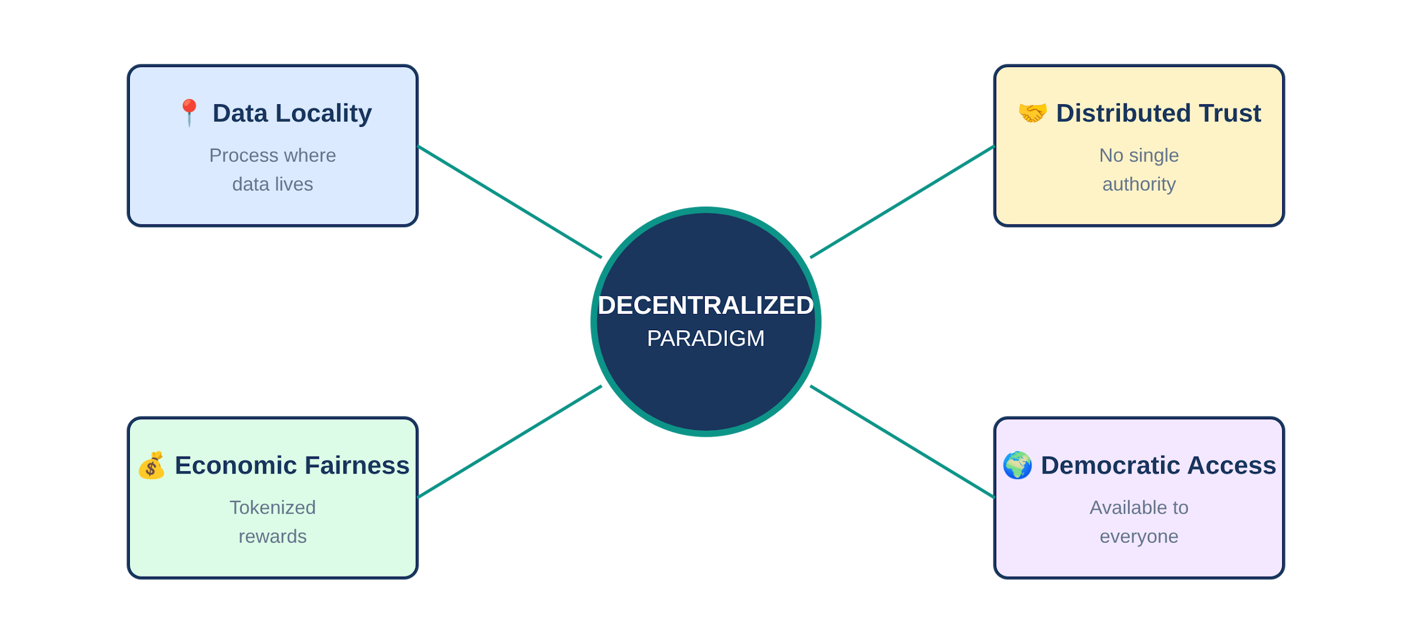
Decentralization Principles

Slide 5
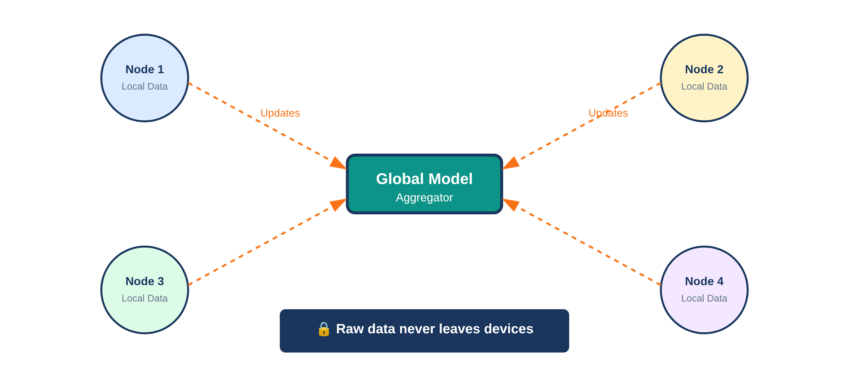
Federated Learning Visualization

Slide 6
Pattern Comparison
Aspect | Centralized | Federated | Distributed
Data Location | Central server | Stays at edge | Stays at edge
Privacy | ✗ Low | ✓ High | ✓ High
Cost | ✗ High | ✓ Low | ✓ Very Low
Scalability | Limited | Good | Excellent
Latency | High | Low | Very Low
Best For | Legacy systems | ML training | Real-time inference

Slide 7
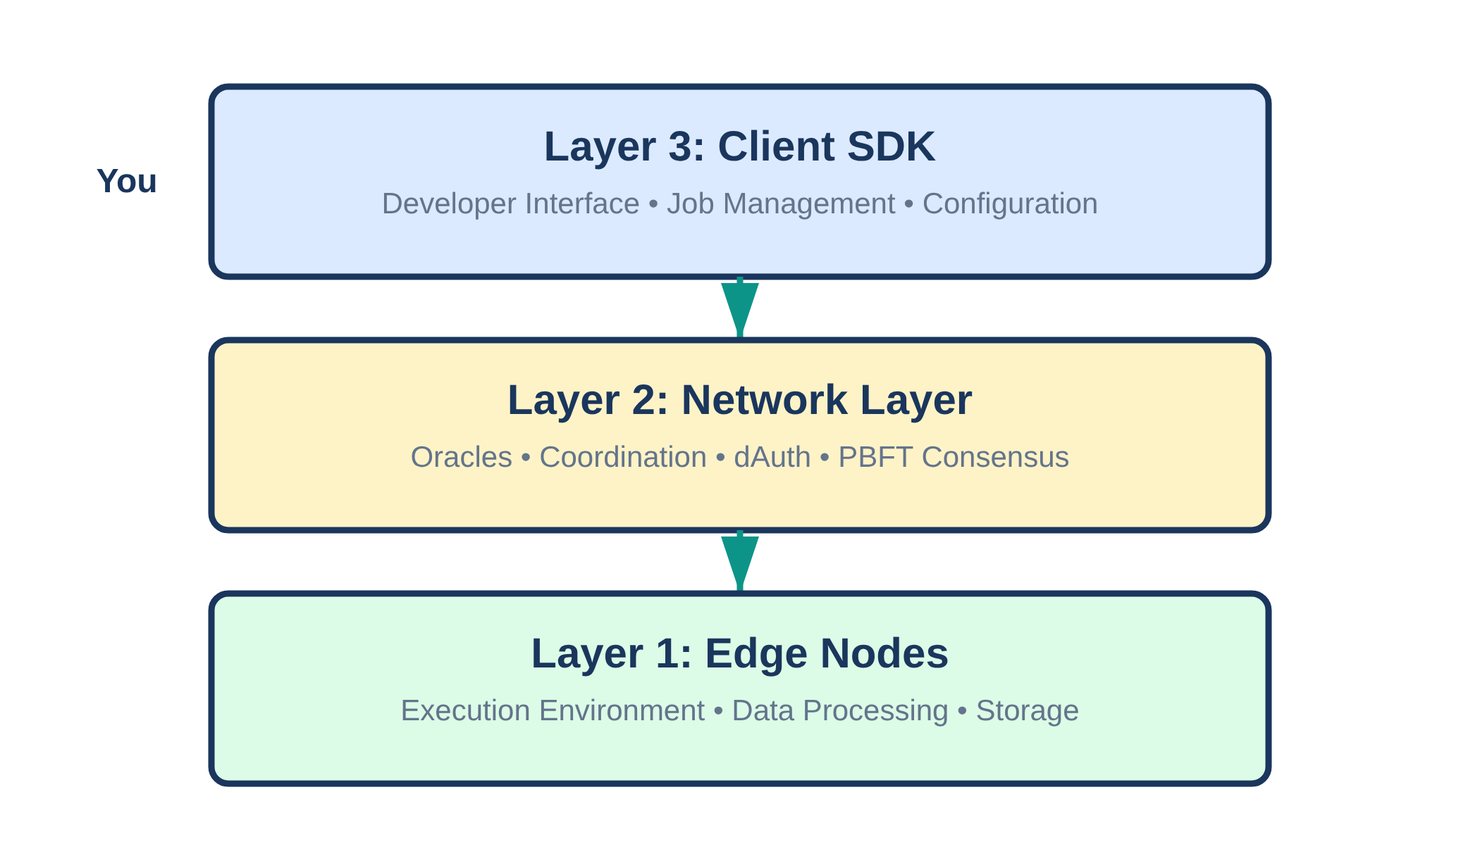
The Ratio1 Stack

Slide 8
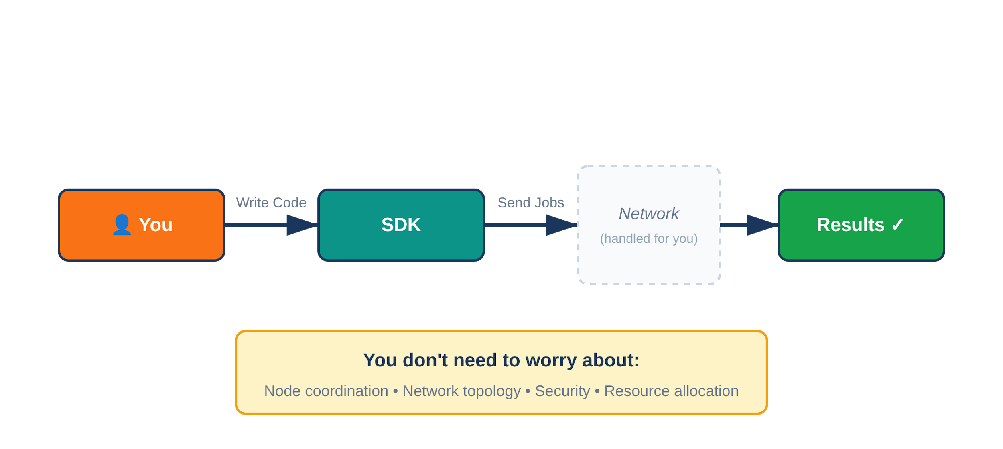
Data Scientist View

Slide 9
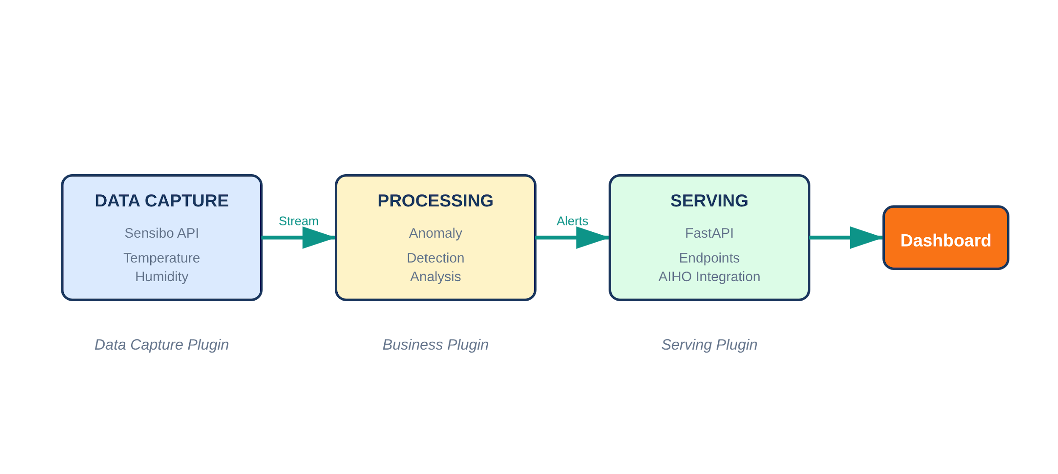
Pipeline in Action: AIHO Example

Slide 10
MLOps Workflow Comparison
Traditional Centralized
Decentralized
1️⃣ Collect all data
1️⃣ Train at edge (local data)
2️⃣ Store centrally
2️⃣ Aggregate updates
3️⃣ Train model
3️⃣ Distribute to nodes
4️⃣ Deploy to production
4️⃣ Inference at edge
5️⃣ Monitor performance
5️⃣ Monitor distributed

Slide 11
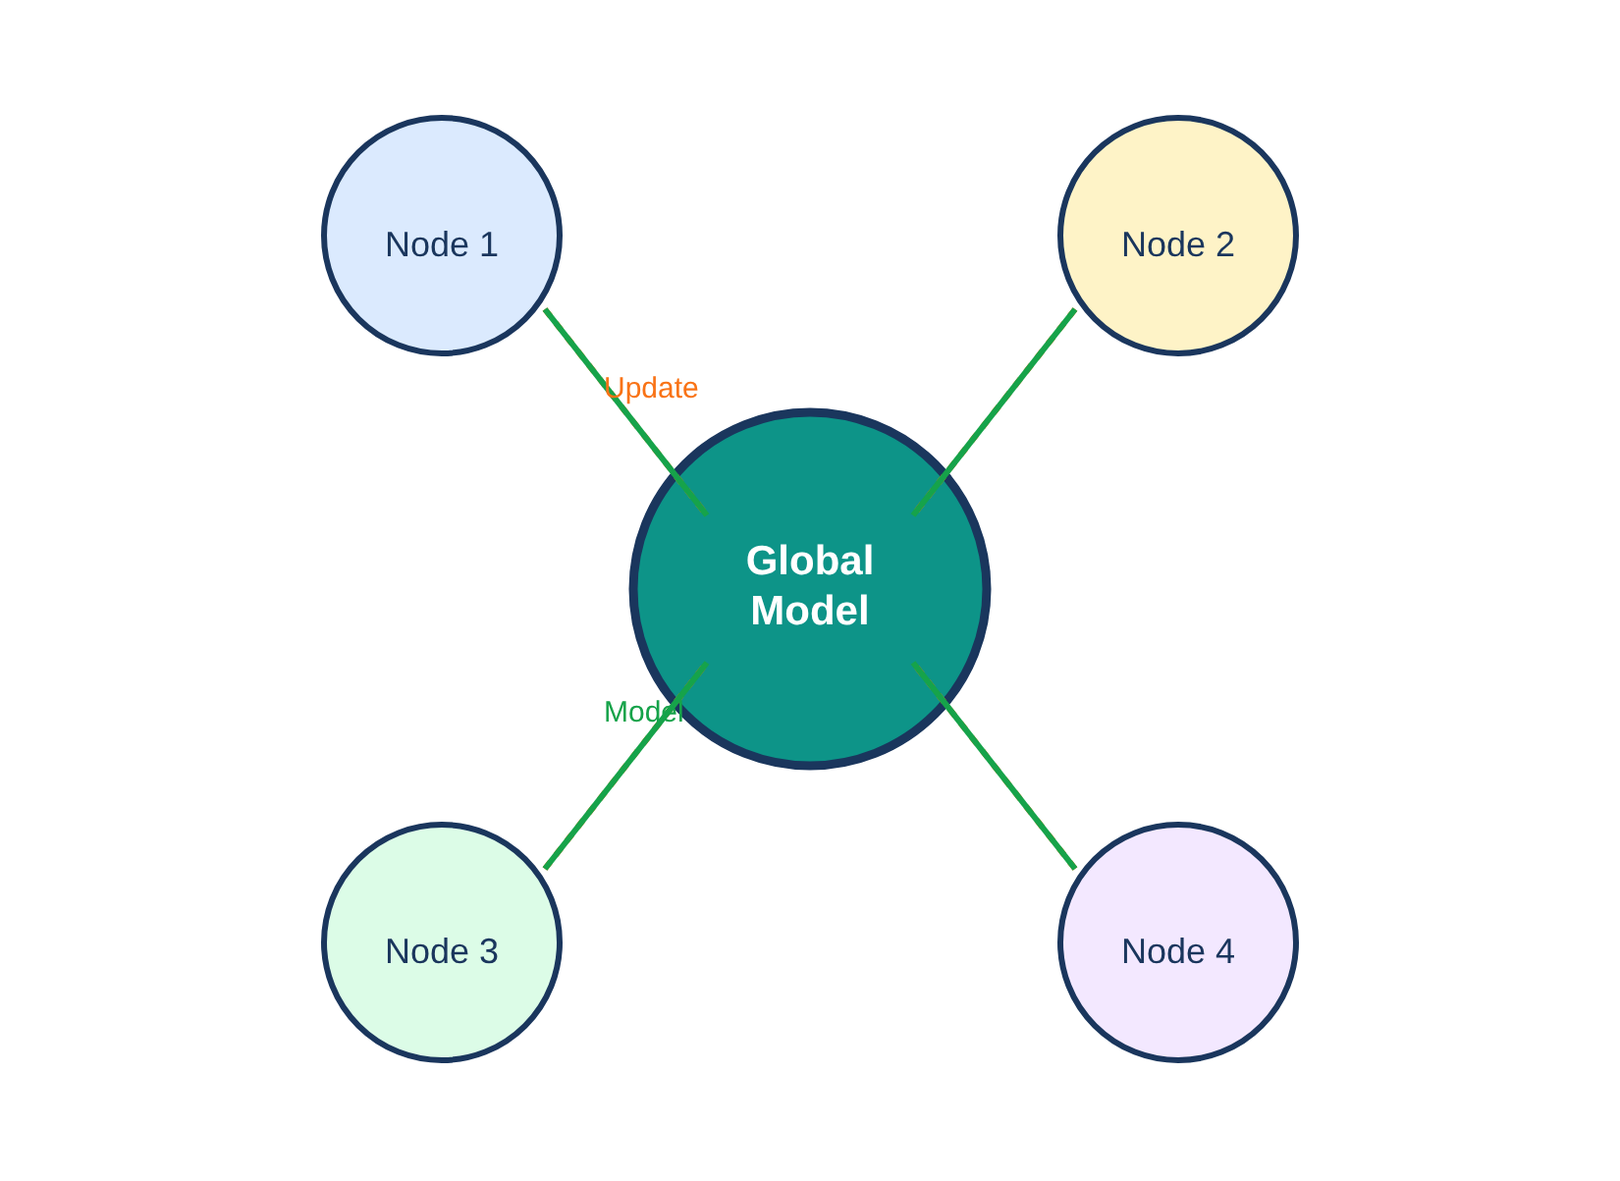
Federated Training: Step-by-Step
Step 1: Initialize global model
Step 2: Distribute to edge nodes
Step 3: Train locally on each node
Step 4: Send updates (not data!)
Step 5: Aggregate & update global
🔄 Repeat cycle until convergence

Slide 12
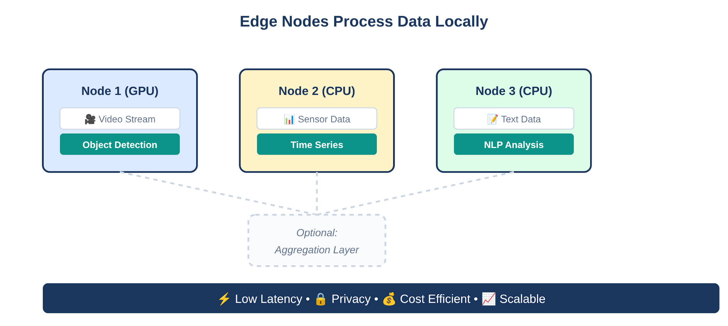
Distributed Inference Architecture

Slide 13
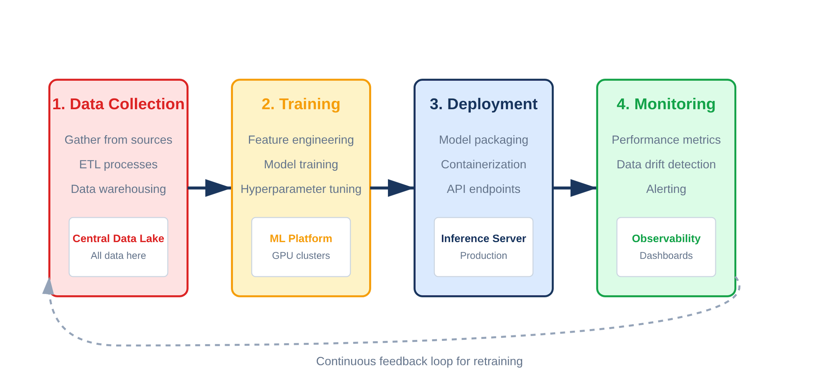
Traditional MLOps Pipeline

Slide 14
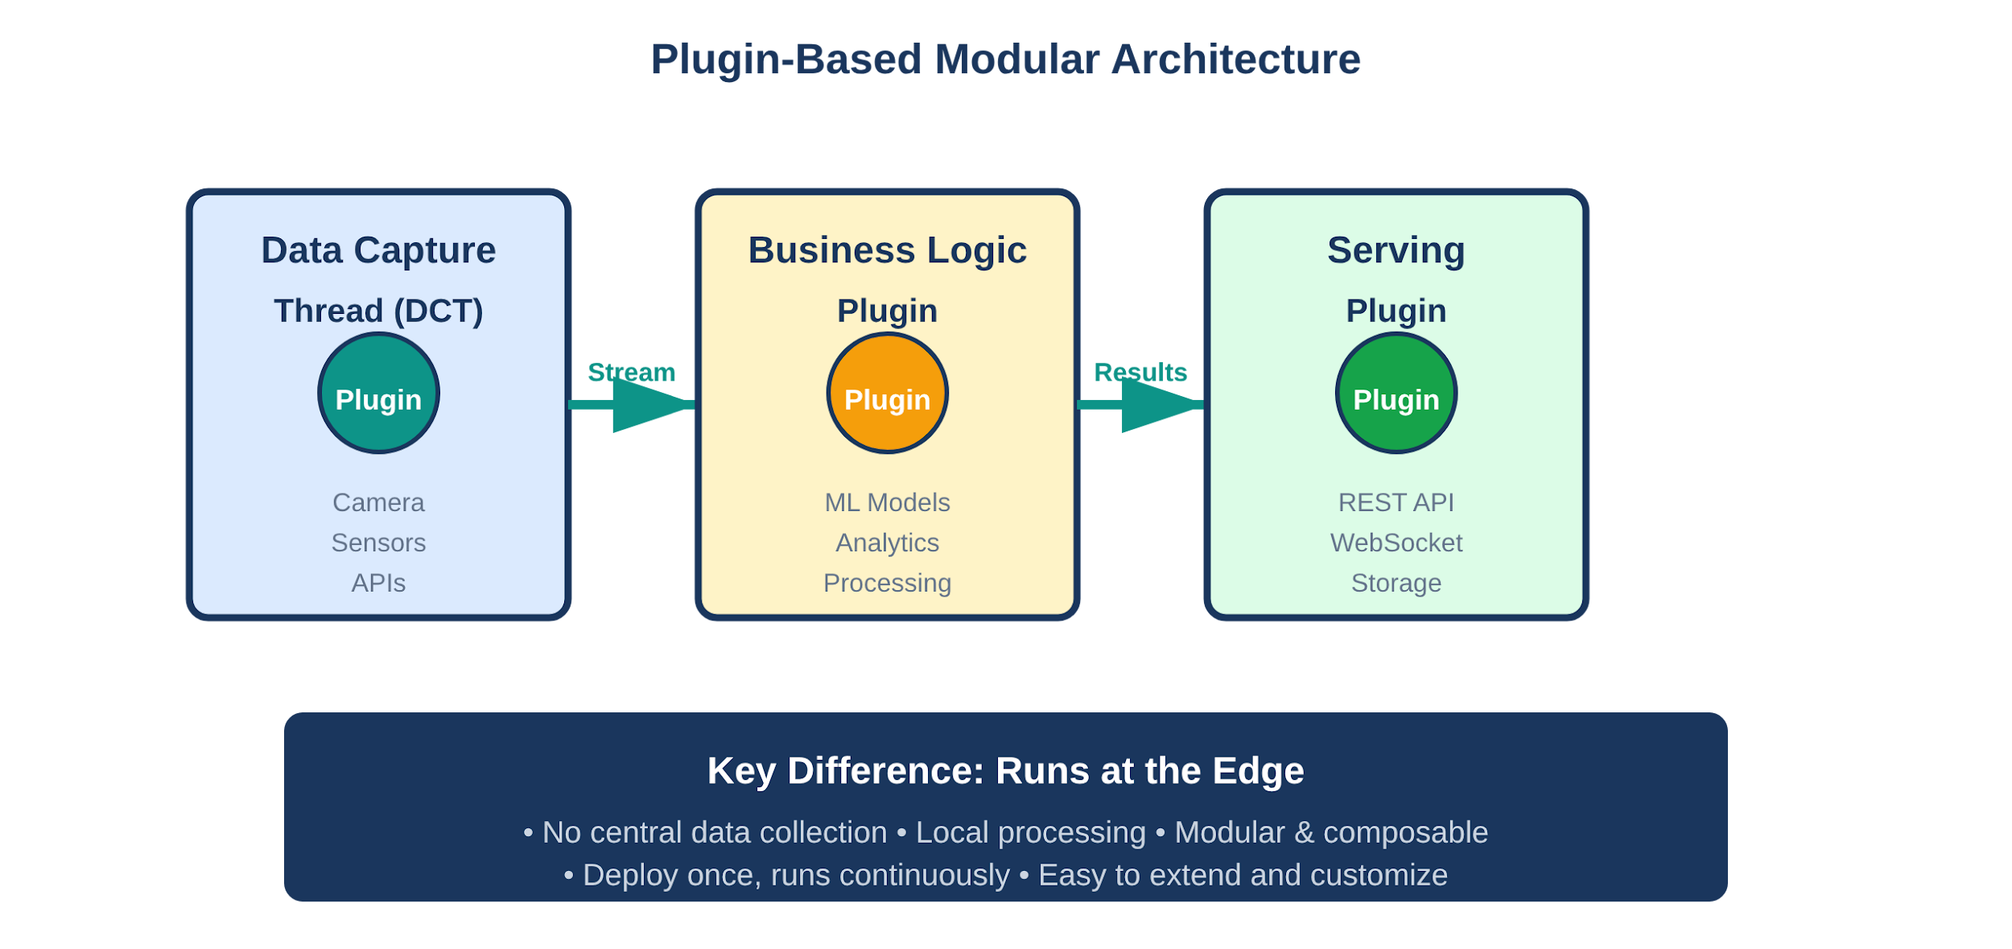
Ratio1 Pipeline Concept

Slide 15
Pipeline Comparison
Traditional Centralized
Ratio1 Decentralized
🔴 Tightly Coupled
✅ Modular Plugins
All stages depend on each other
Independent, reusable components
🔴 Data Centralization
✅ Data at Source
Must collect all data first
Process where data originates
🔴 Manual Orchestration
✅ Auto Orchestration
Airflow, Kubeflow, custom scripts
Built-in pipeline management
🔴 Separate Deploy
✅ Unified Runtime
Training and serving are different systems
Same environment for train and serve

Slide 16
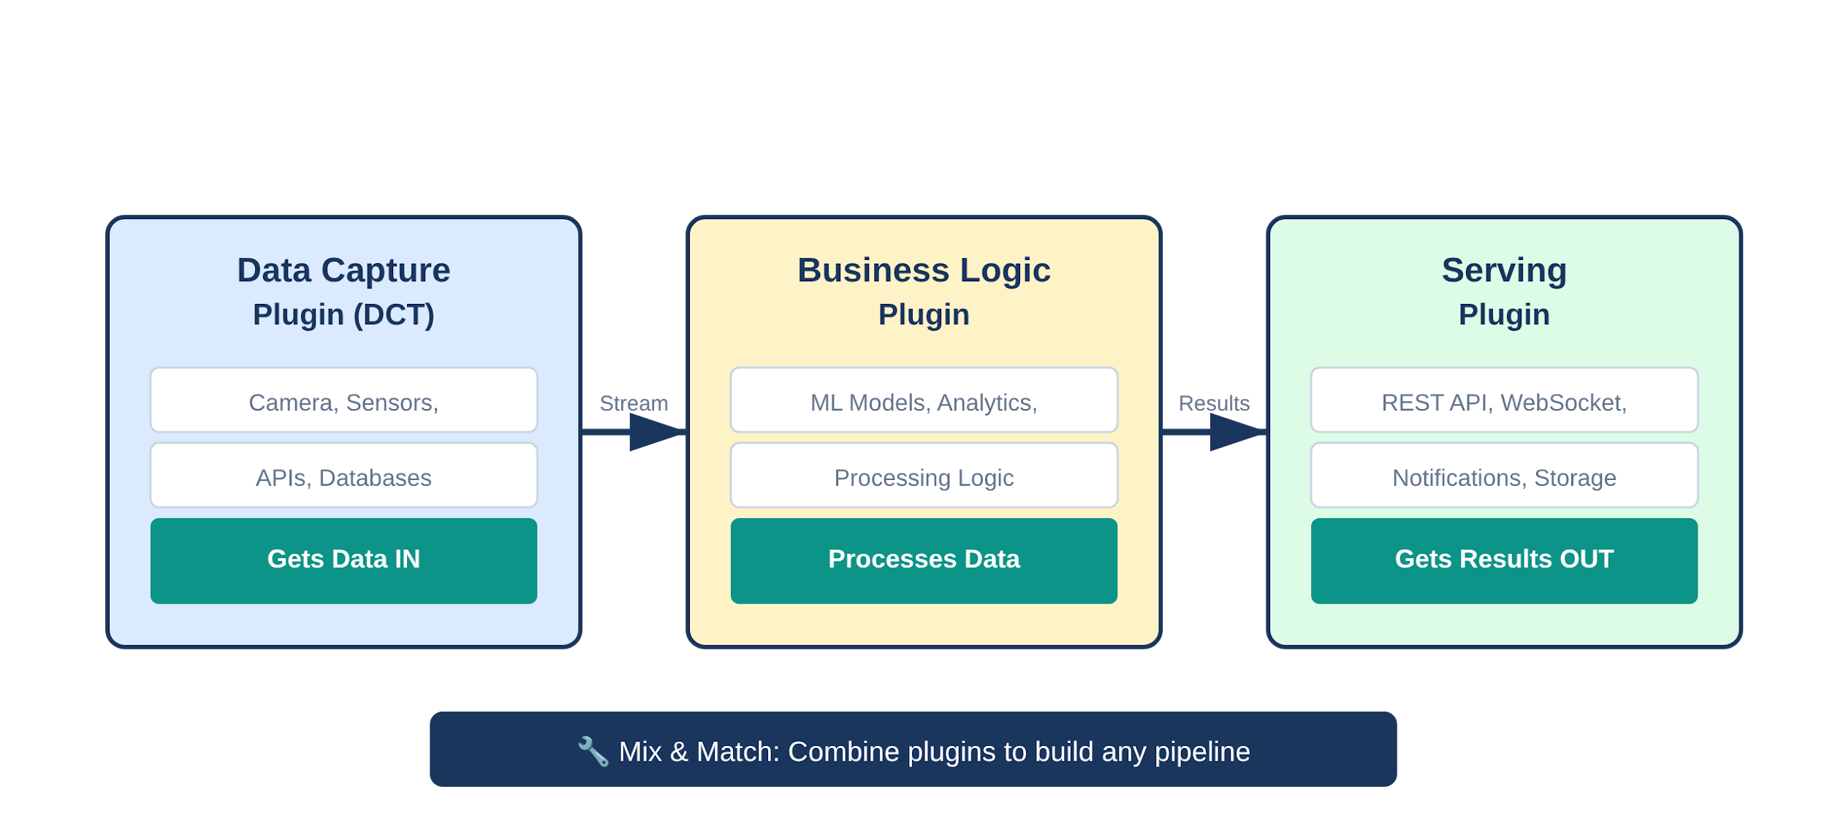
Plugin Architecture

Slide 17
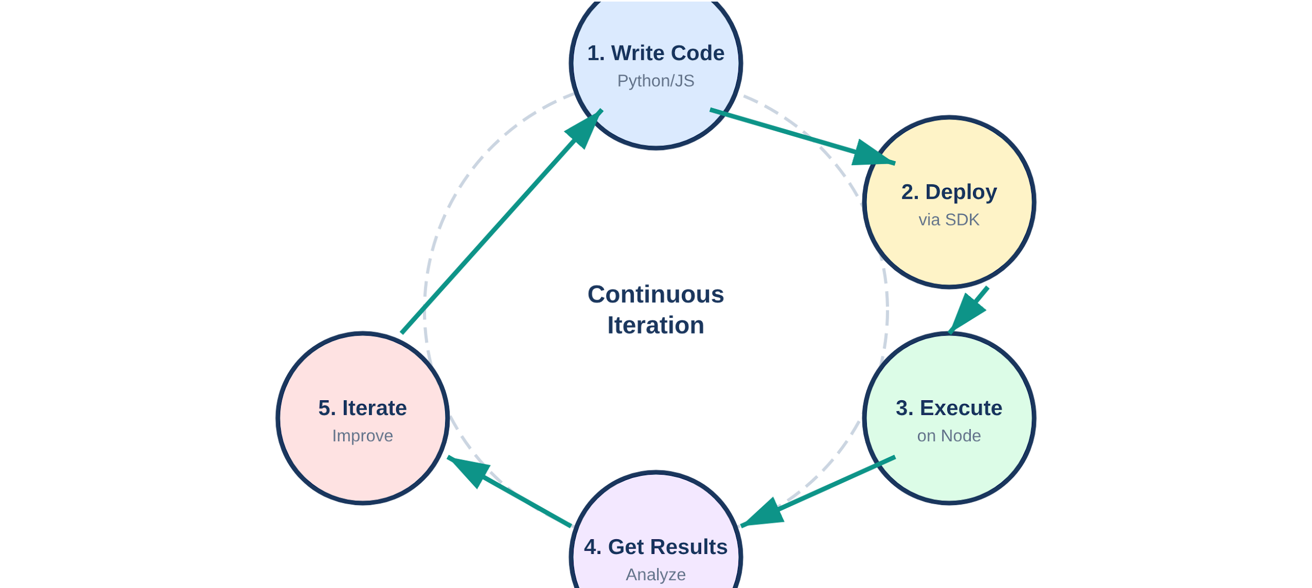
Development Workflow

Slide 18
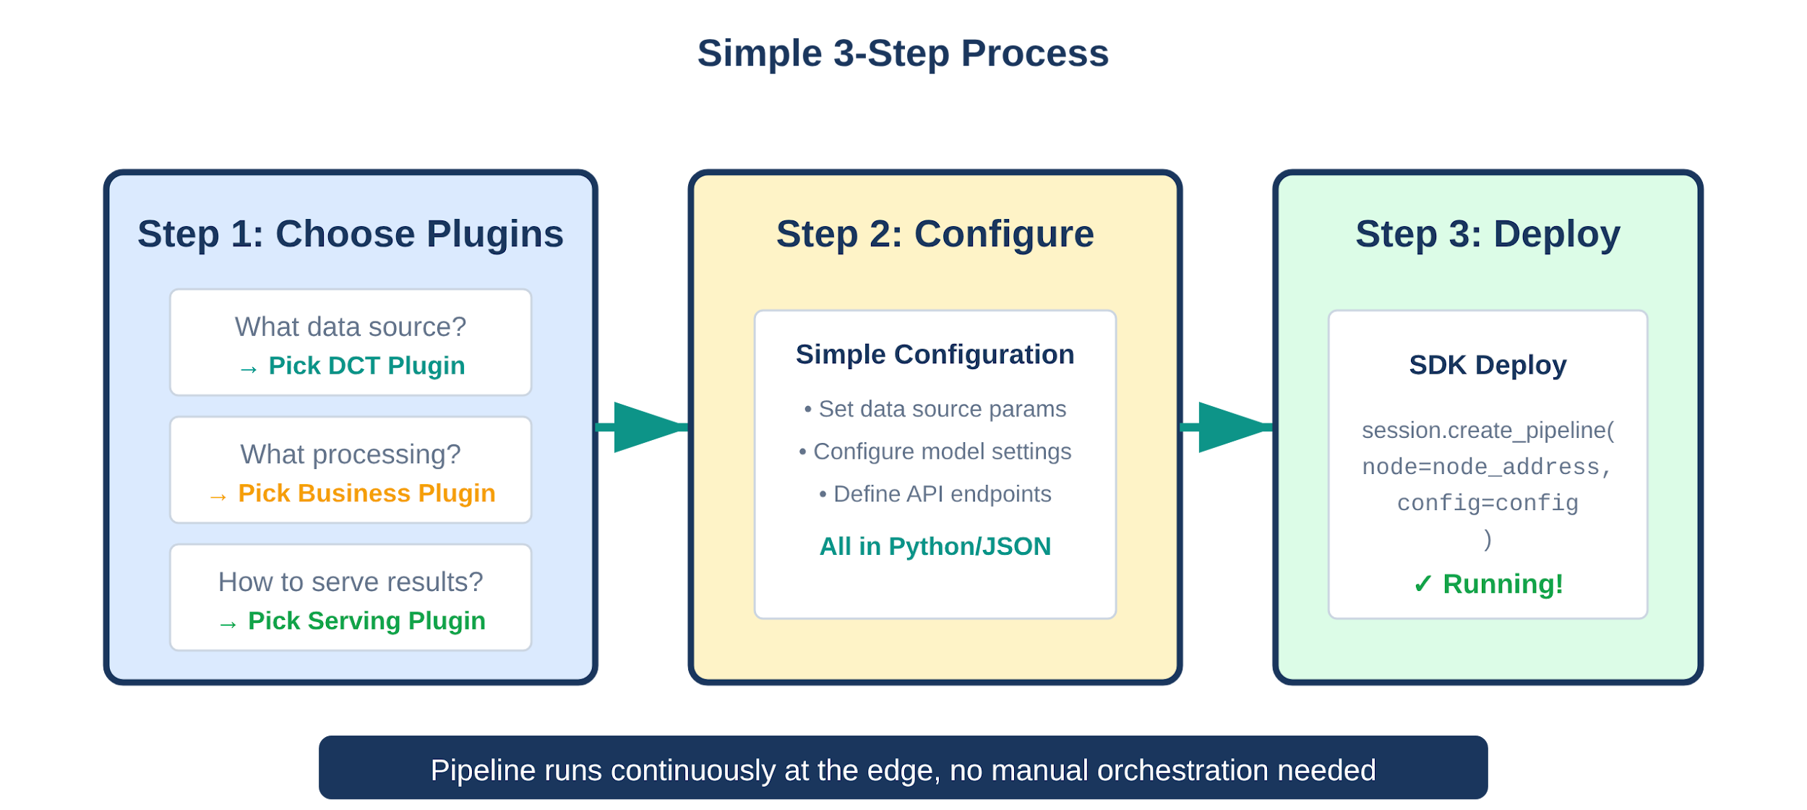
Building Your First Pipeline

Slide 19
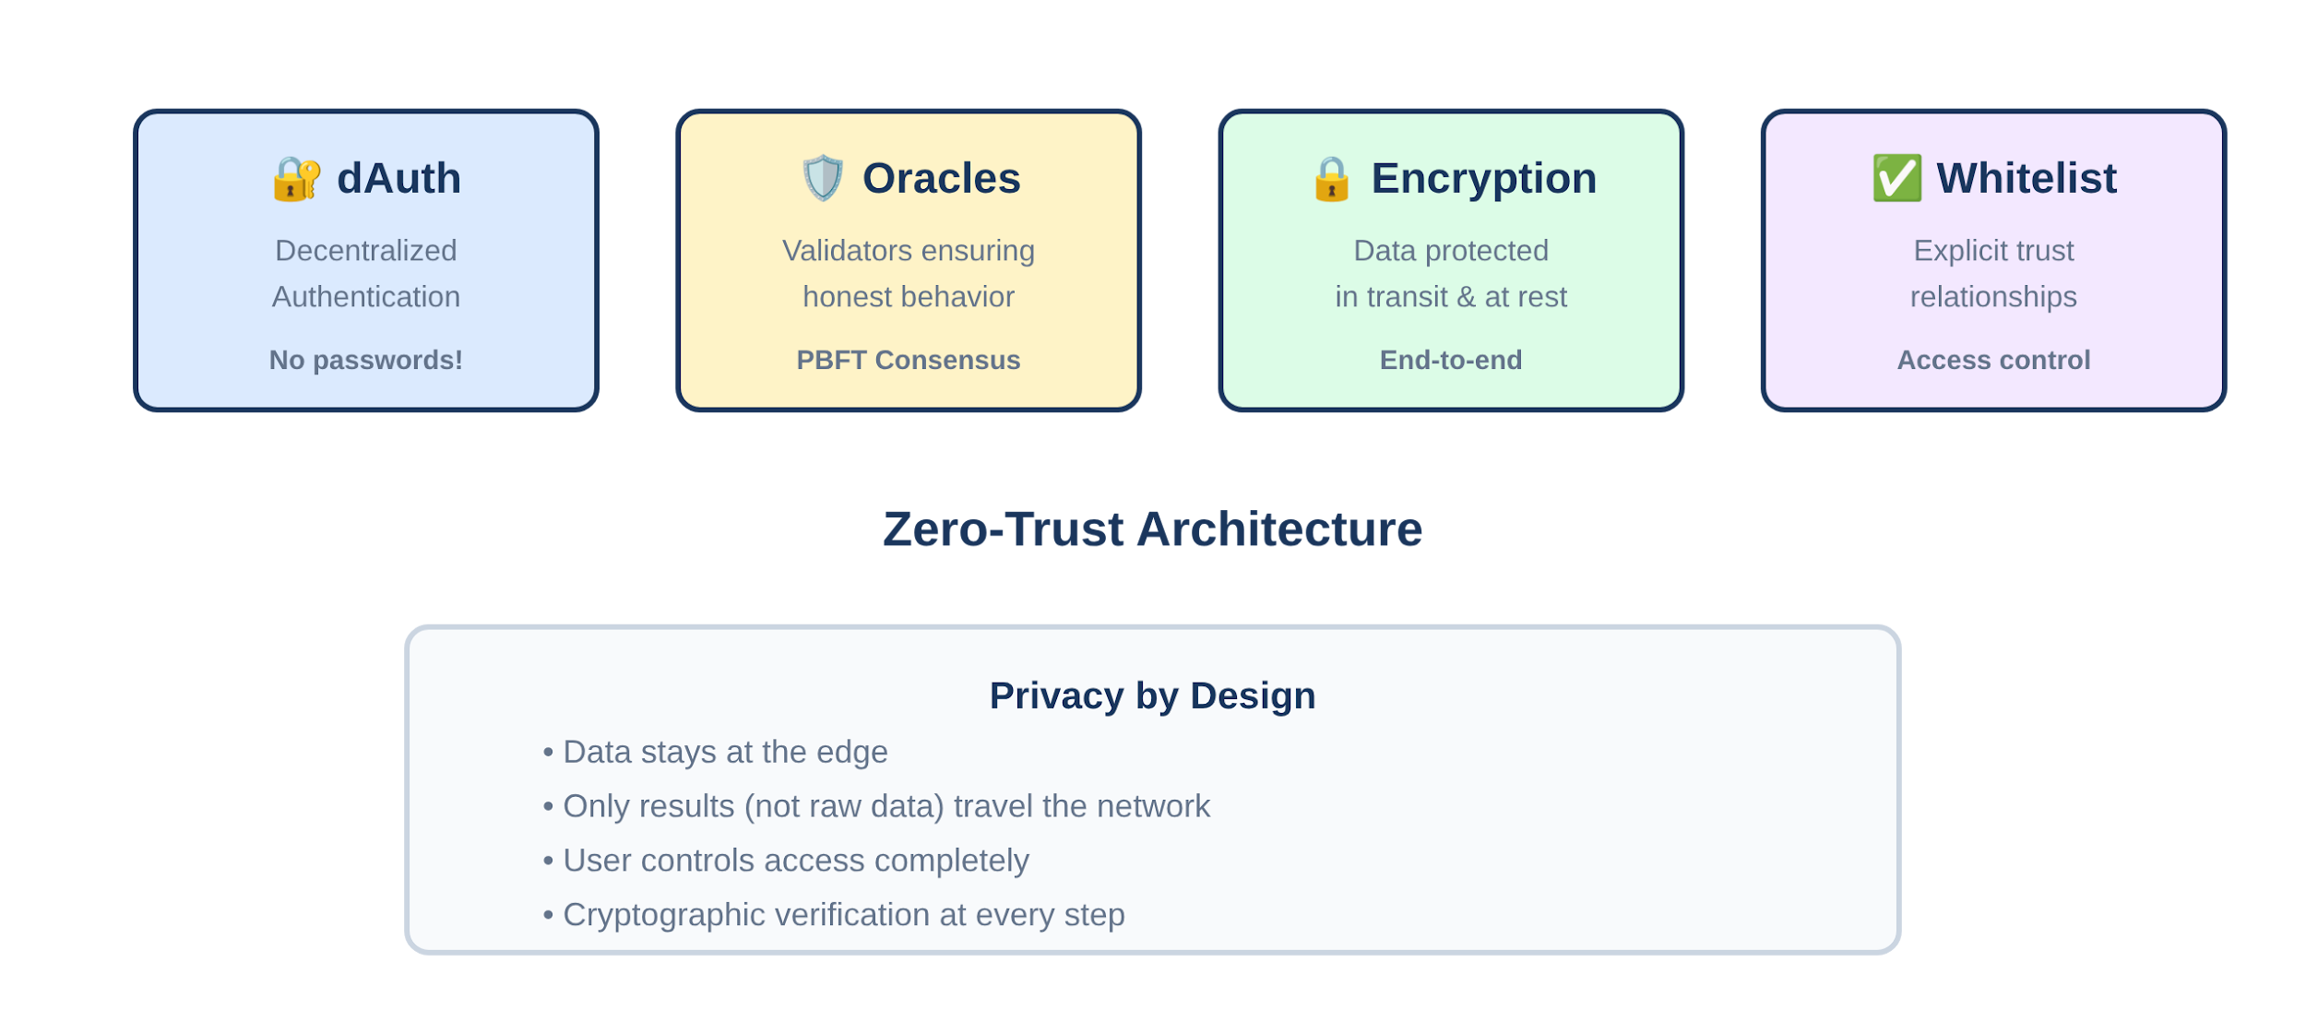
Security & Trust Architecture

Slide 20
Best Practices & When to Use
✅ Design Principles
✅ When to Use
Keep plugins simple and focused
Privacy is critical
Design for failure (nodes can go offline)
Data is distributed geographically
Minimize data movement
Cost is major factor
Monitor everything
Need resilience & redundancy
❌ Common Pitfalls
❌ When NOT to Use
Assuming all nodes always available
Simple, small-scale problems
Sending too much data over network
Centralized working fine

Slide 21

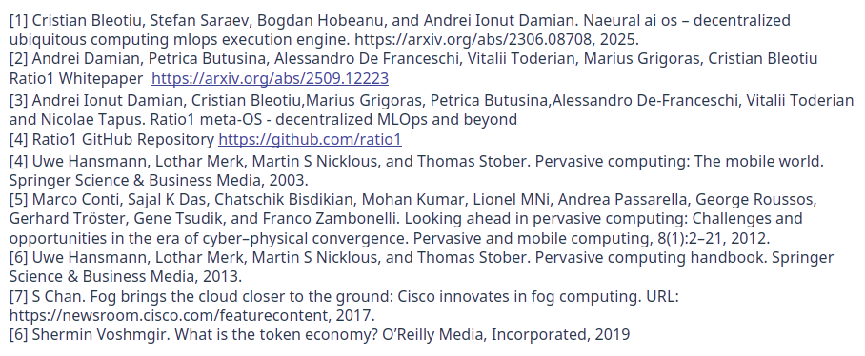

Slide 22


